Slide 1
Achieving Fair Maps in Georgia
Joint Senate and House Redistricting Committees
Janet Grant, Vice Chair
Aug 30, 2021

Slide 2
About Fair Districts GA
Fair Districts GA is a nonpartisan grass roots citizens’ group that works to end electoral map rigging in Georgia.
Our focus is to fight gerrymandering, the practice of drawing legislative district lines to favor one group over another.
Our ultimate goal is to reform Georgia’s process for drawing state and federal electoral maps.
Georgia is now a swing state. Our legislative and congressional districts should reflect this new reality.
Fair elections require fair voting rights and fair districts.

Slide 3
About Princeton Gerrymandering Project
The Princeton Gerrymandering Project (PGP) does nonpartisan analysis to understand and eliminate partisan gerrymandering at a state-by-state level
Use state-of-art ensemble methods to create a normative collection of maps to understand what a map would look like without bias
Serve as experts in federal and state courts
“We bridge the gap between mathematics and the law to achieve fair representation through redistricting reform.”

Slide 4
What do we mean by fair maps?
Respect voters’ political preferences
Reflect the natural political preferences of voters distributed across the state
Sufficiently competitive
Reflecting Georgia’s diversity
Sufficient majority-minority districts per VRA
Preserve minority opportunity / influence districts
Honor communities of interest

Slide 5
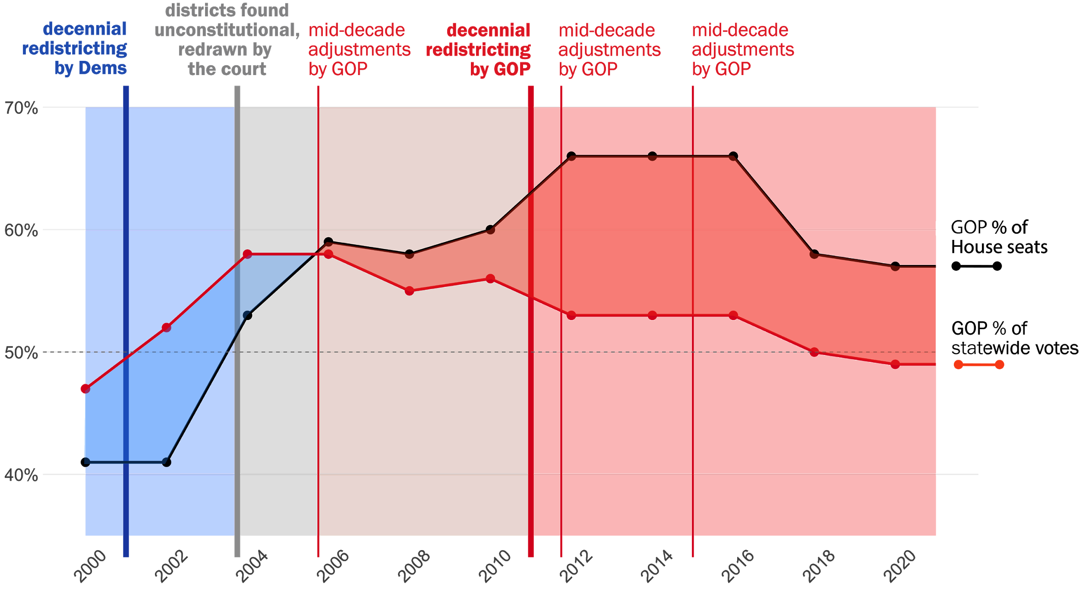
State House: Partisan Advantage
Principle:
More votes = More seats
Fewer votes = Fewer seats
More seats
Super-
majority
More votes
Fewer votes
Notes: statewide votes = president, senate, governor.
Seats counted as elected, excludes party switches
Same seats
Source: FDGA analysis of GA Secy. of State election data
Notes:
Looking at the last 20 years together, you can see that both parties used redistricting to maintain partisan control. The red line shows the GOP vote share, and the black line shows the seat share.
When the Democrats controlled redistricting - the time periods with the blue background - the GOP vote share increased, but the seat share in the House didn’t change
When the courts drew the lines - the time with the gray background - House seat share moved more in line with voter preferences, and the seat-share responded to the vote-share
And then when the GOP controlled decennial redistricting in 2011 - the time periods with the red background - their vote share decrease and their seat share actually increased to a supermajority
The only time when the voter preferences and seat share are aligned was after the courts drew the maps
% of seats shows seats won in the election.
After 2002 election, 2 elected Democrats switched parties for 2003-4 leg session.
After 2004 election, 3 elected Dems switched to Rep for 2005-06 session.

Slide 6
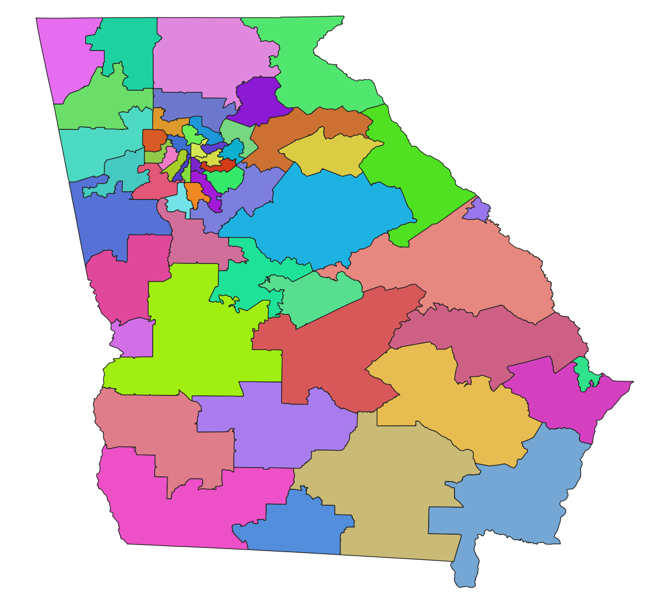
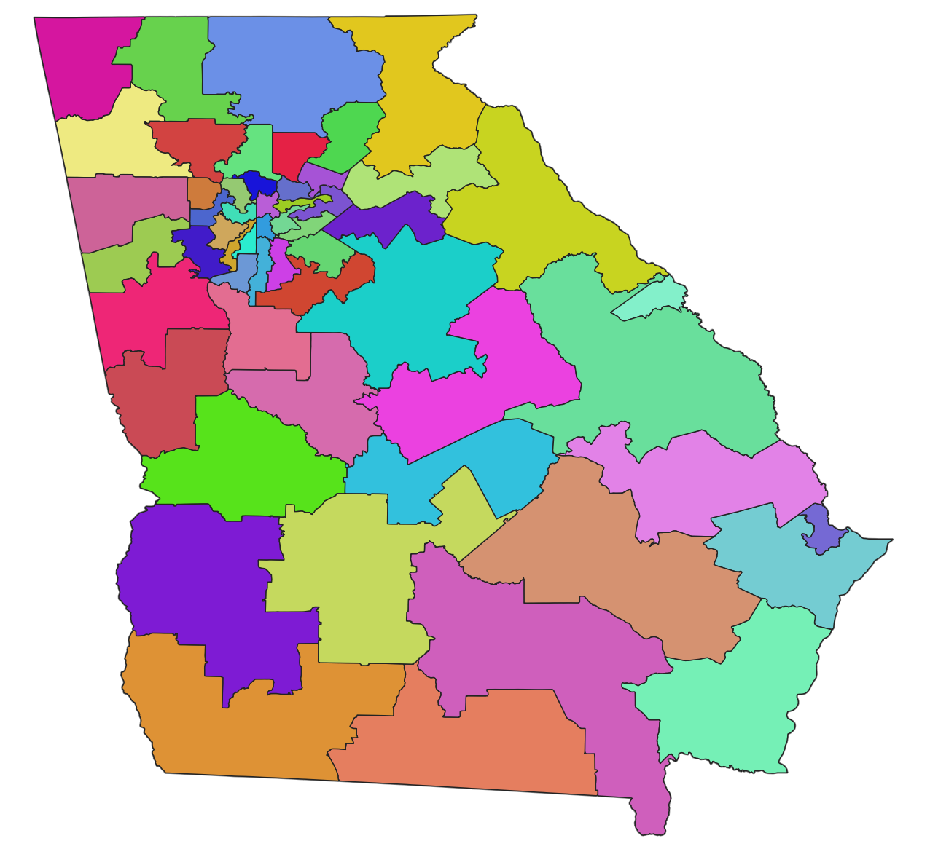
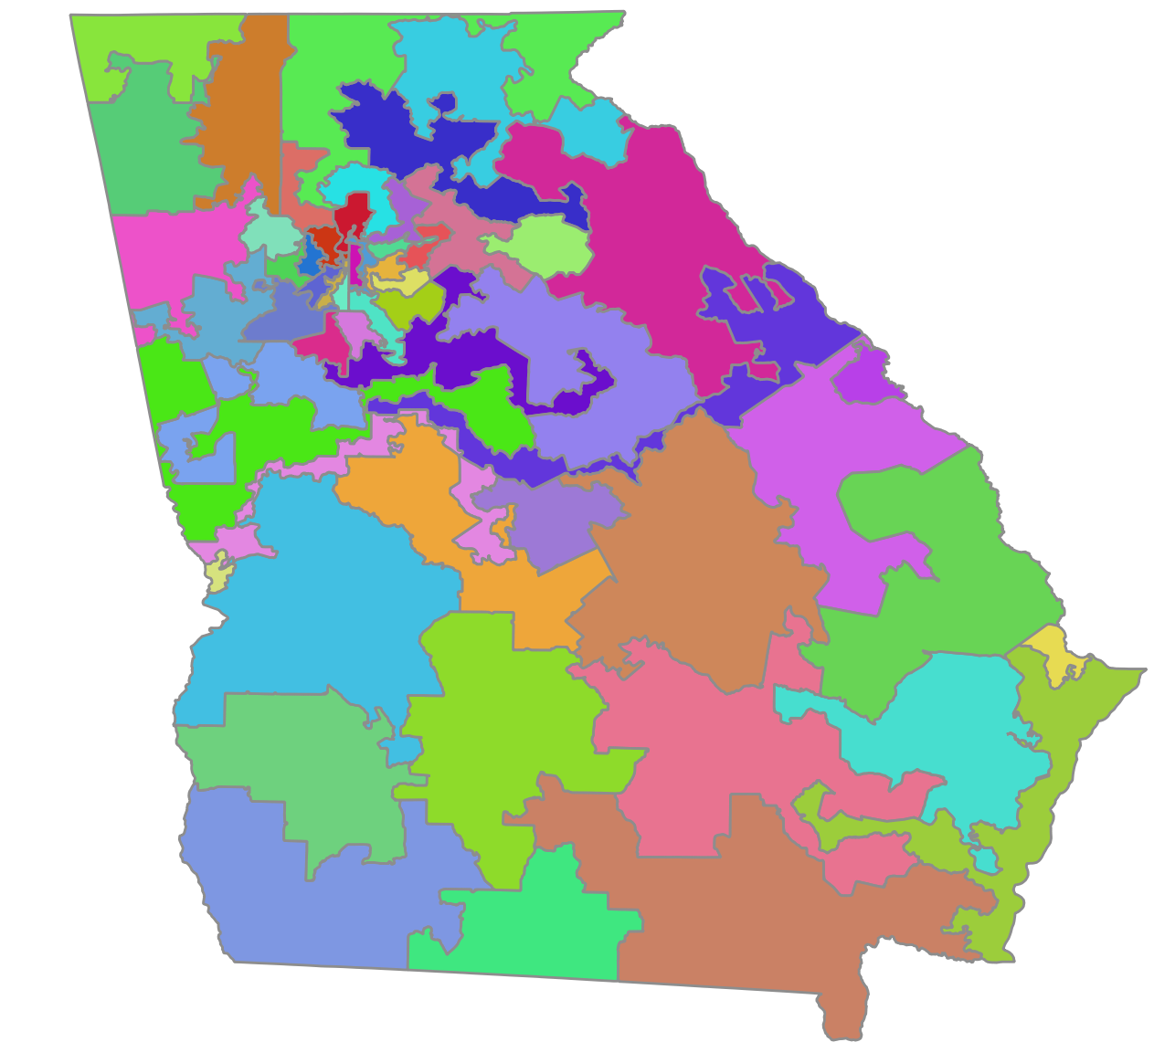
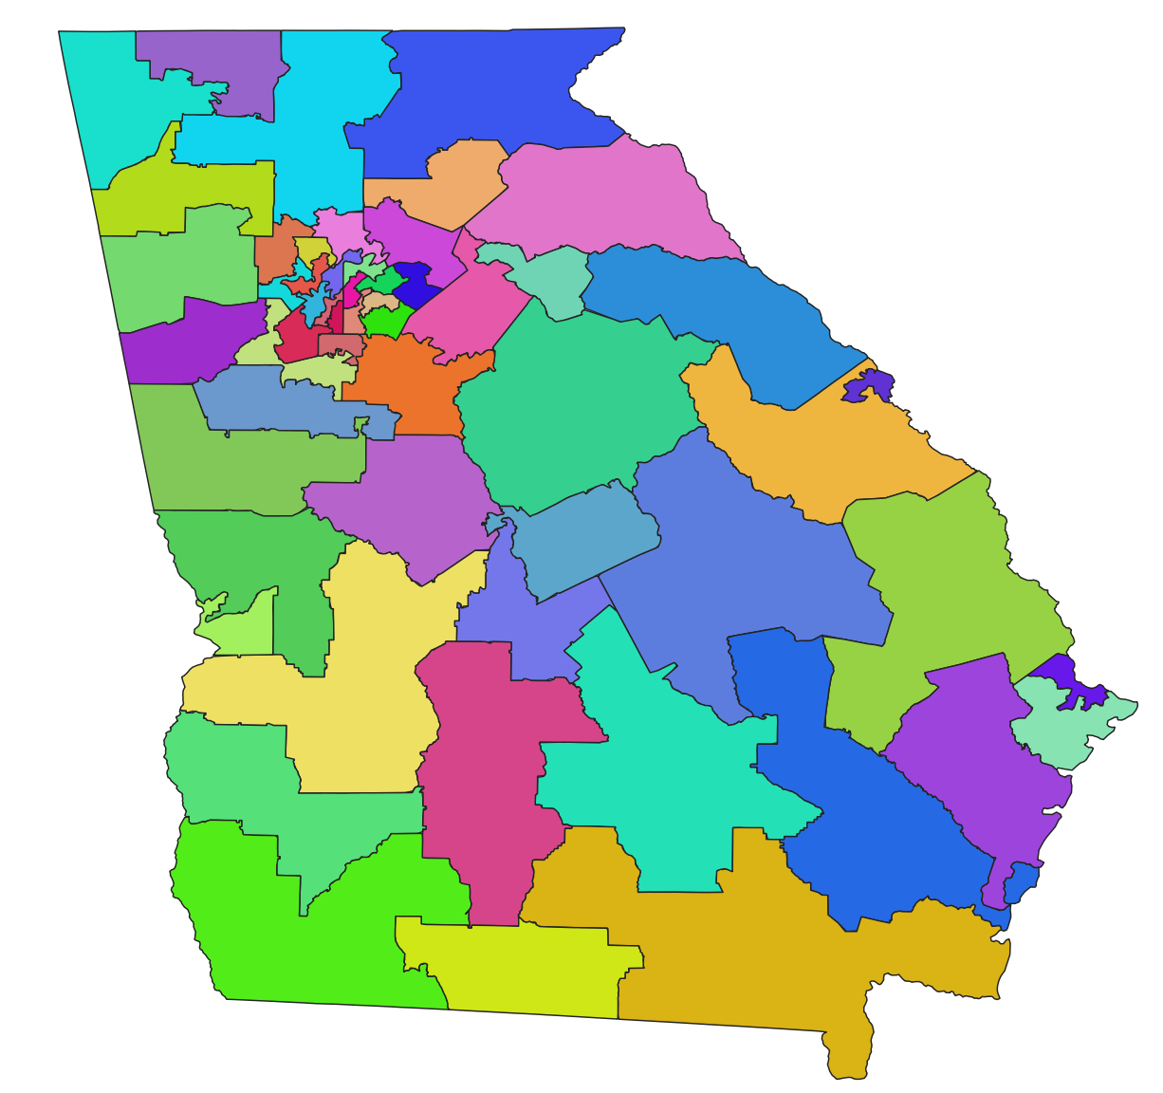
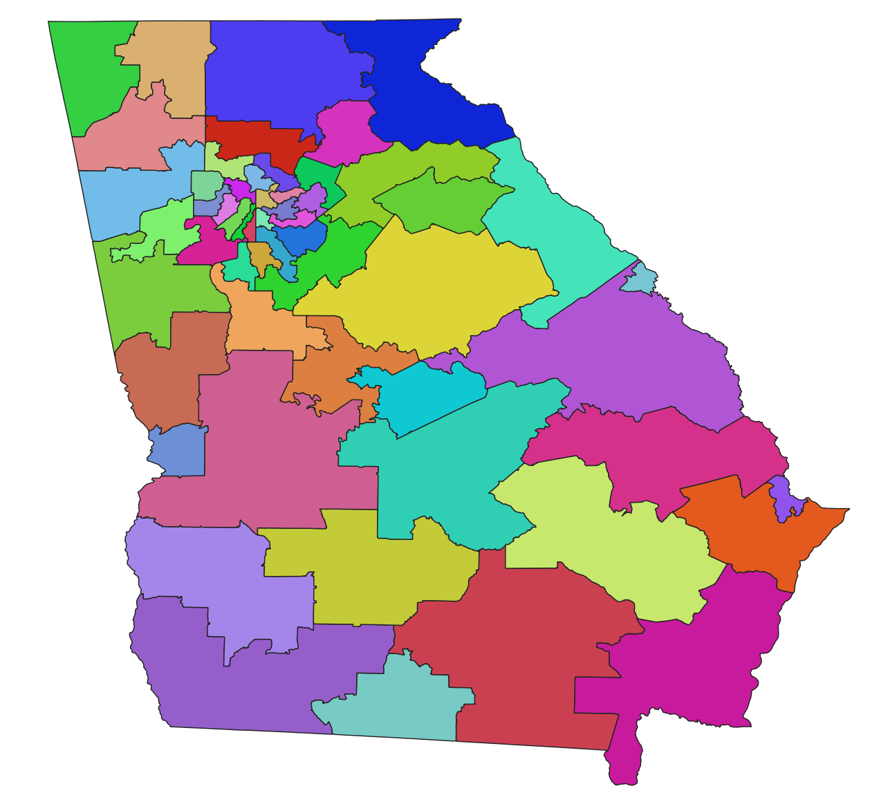
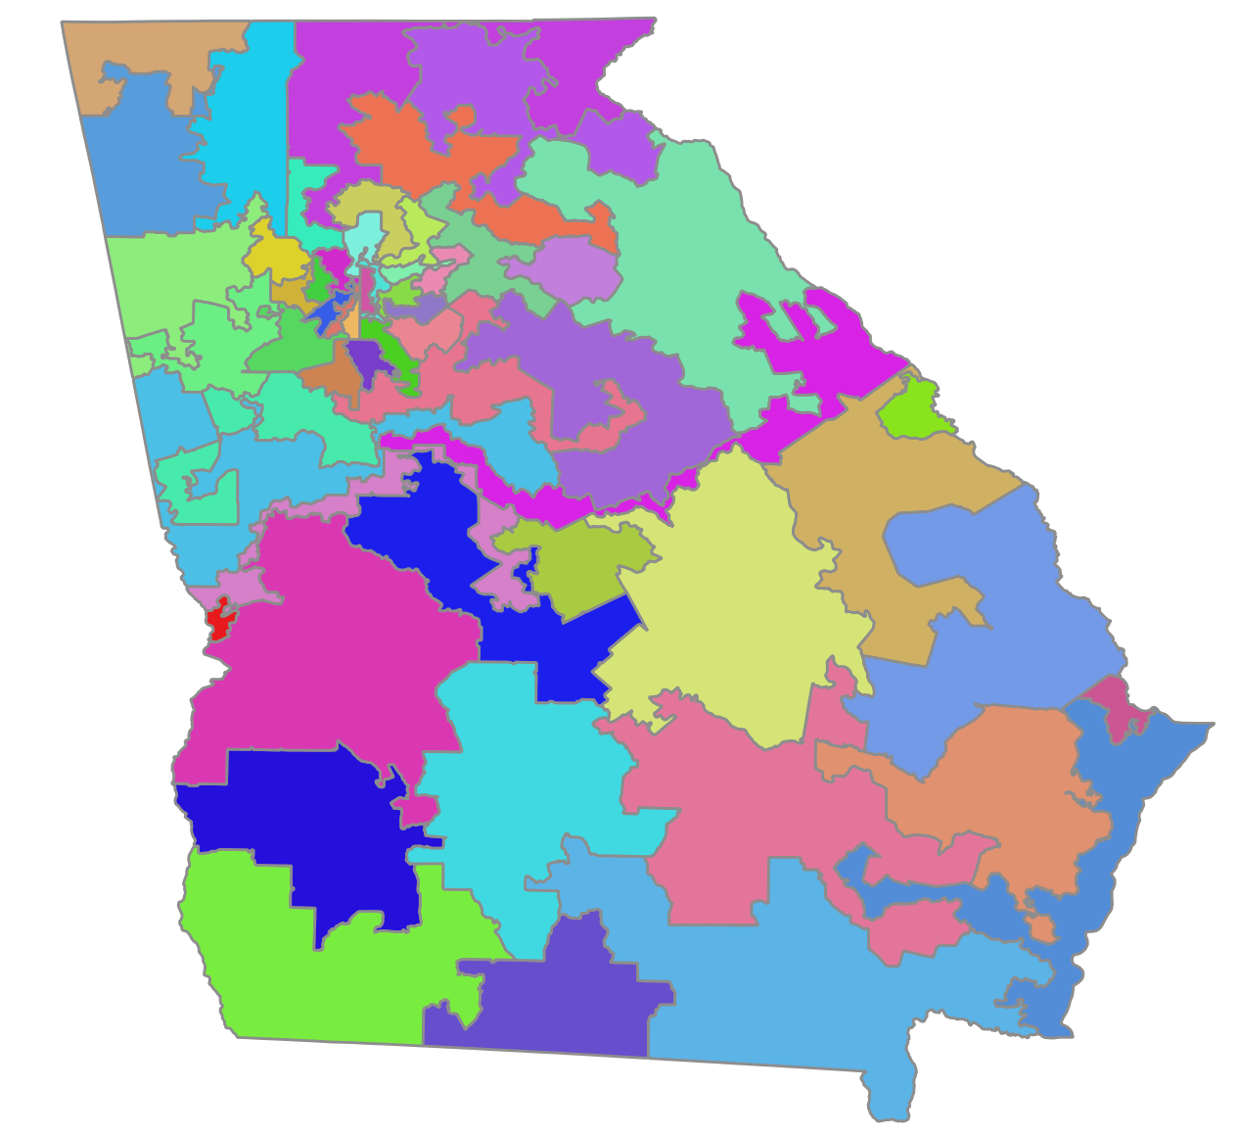
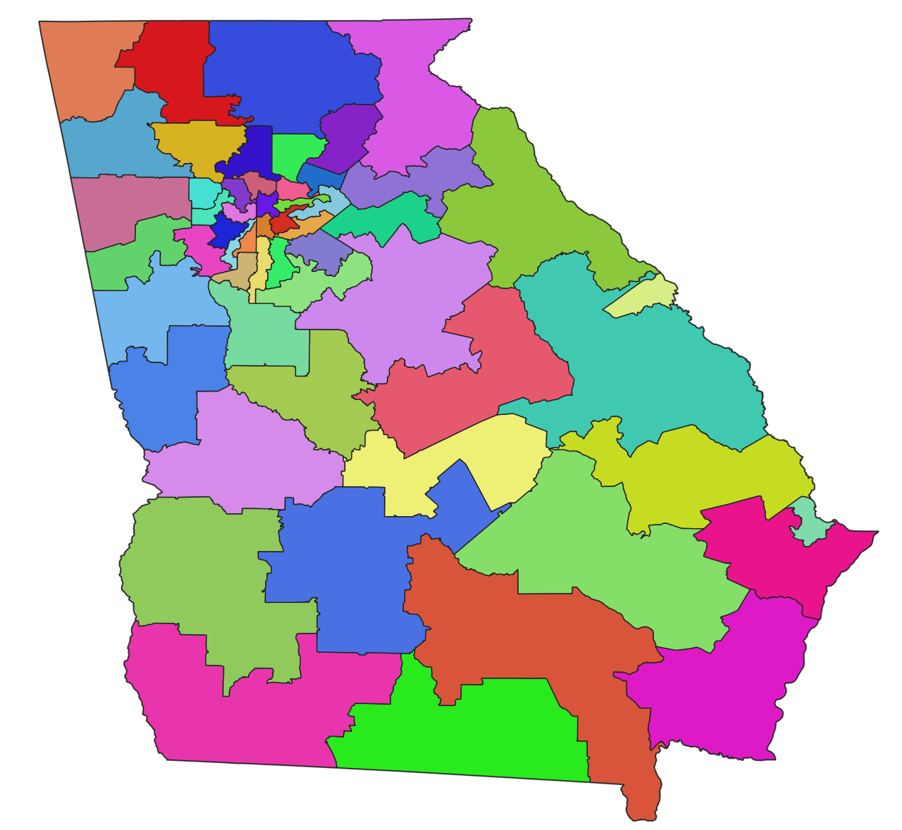
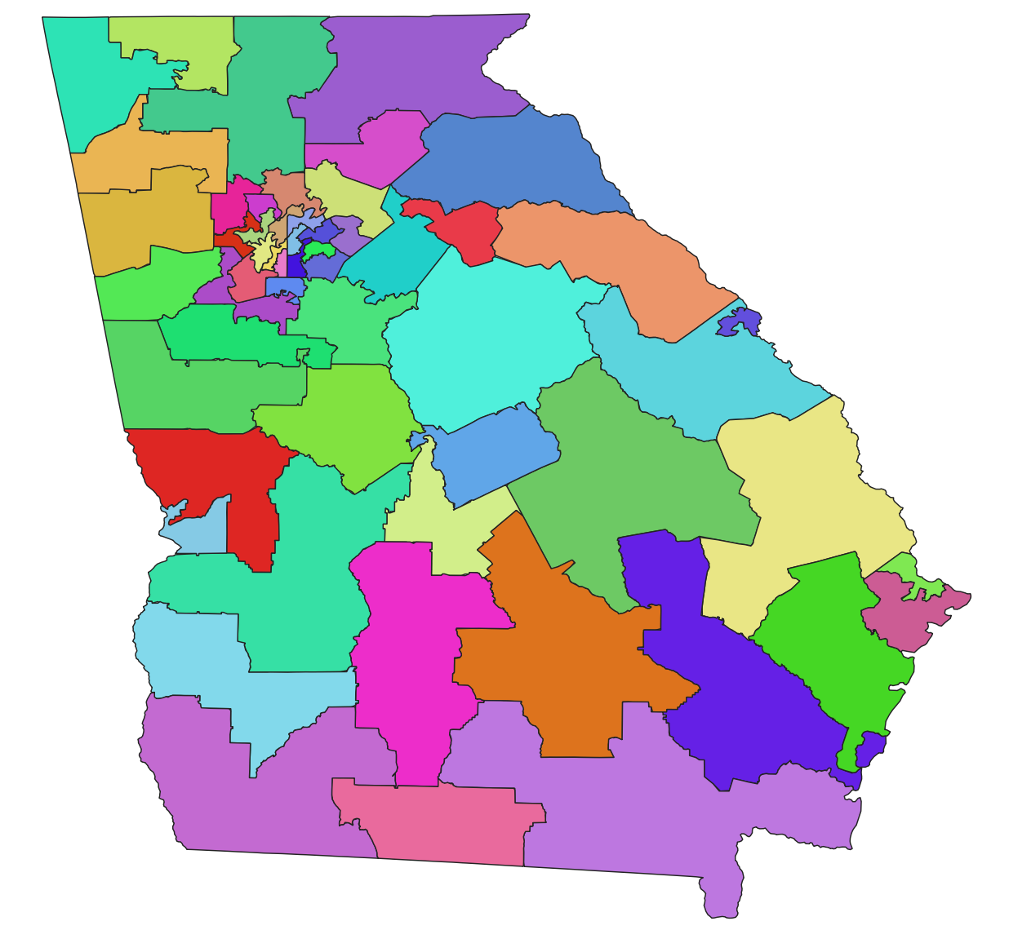
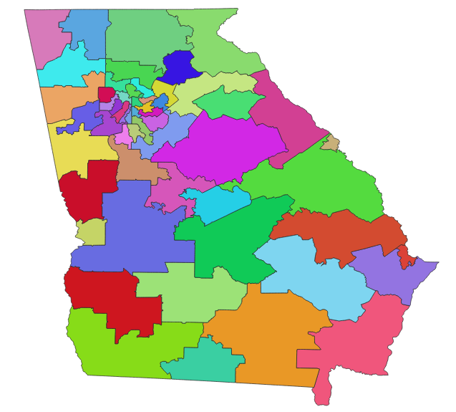
Creating Fairness Benchmarks Using Computer Simulated Maps
Princeton Gerrymandering Project simulation
Create ~500,000 maps for Congress, Senate and House based on 2020 census
Comply with laws and traditional redistricting criteria
Maintain current number of VRA-compliant districts
Use average of 3 recent statewide elections for President, Governor and Senate

Slide 7
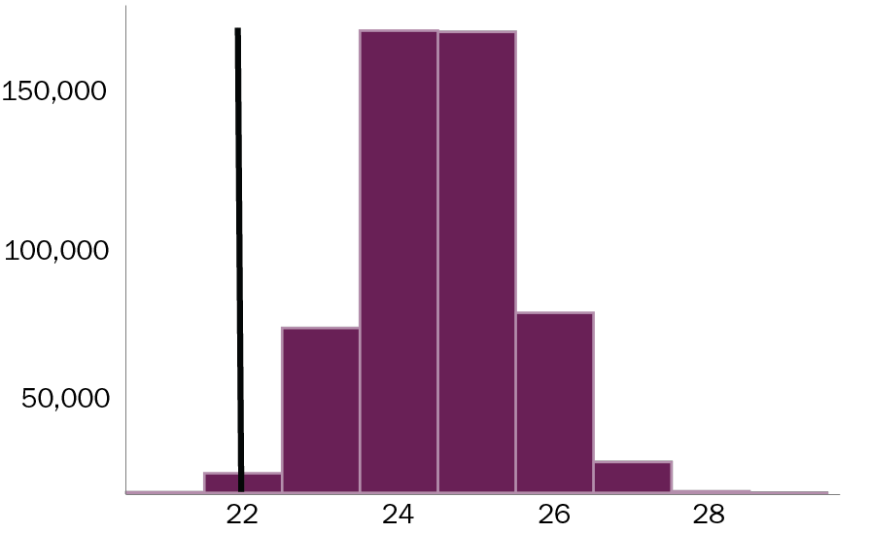
Benchmark example: Partisan balance in a 52-district map
Enacted map = 22 “Party A” districts
In 500,000 simulated maps:
Natural partisan preference slightly favors Party B
Party A = 22-27 districts
Party B = 25-30 districts
98% of maps have 1-5 more “Party A” districts than enacted map (22)
Count of maps
Estimated “Party A” districts
applying an average of three elections (2016-2020)

Slide 8
Benchmarks and map evaluation 2010-2020 historical view of current maps
 | Benchmarks / Fairness tests (compared to unbiased maps) |  |  | Observations
 | Partisan balance | Competitive districts | Minority representation
State House | X 1-7 fewer Dem districts than 83% of unbiased maps | 23 competitive districts, more than 81% of unbiased maps | 47 Black majority districts (as expected) 8 opportunity districts (more than expected) | Decennial gerrymandering Dems – 2001 Reps – 2011 Extensive mid-cycle redistricting 2/3 of small cities split Black voter packing and cracking
State Senate | X 1-6 fewer Dem districts than 98% of unbiased maps | X 1-9 fewer competitive districts than 91% of unbiased maps | X 15 Black majority districts (as expected) Missing 1-3 opportunity districts compared to 98% of unbiased maps | Decennial gerrymandering Dems – 2001 Reps – 2011 Extensive mid-cycle redistricting Black voter packing and cracking eliminates opportunity districts
Congress | Balanced as of 2016-2020 | 2 competitive districts, 78% have 1-2 | 4 Black majority districts (as expected) Slight chance to create 1 opportunity district | Mid-cycle redistricting Demographic shift has increased competitiveness of 2011 map

Slide 9
FDGA / PGP benchmarks and map evaluation
 | Benchmarks / Fairness tests (range of values based on final 2020 census data)
 | Partisan balance | Competitive districts | Minority representation
State House | Republicans: W-X districts Democrats: Y-Z districts | X-Y competitive districts | W-X Majority-minority districts Y-Z opportunity districts
State Senate | Republicans: W-X districts Democrats: Y-Z districts | X-Y competitive districts | W-X Majority-minority districts Y-Z opportunity districts
Congress | Republicans: W-X districts Democrats: Y-Z districts | X-Y competitive districts | W-X Majority-minority districts Y-Z opportunity districts
Benchmarks will use 2020 census data + 2018-2020/21 election data
Evaluation of maps released by legislature

Slide 10
Why Should We Adopt Independent Benchmarks?
Fairer districts – and provides the justification
Transparency – check by independent experts
Restores public trust and confidence in the process
Demonstrates compliance with Voting Rights Act
May help avoid costly litigation

Slide 11
Fair Districts GA and Princeton as Resources
Available to consult and review draft maps using benchmarks
Fair Districts legislator resource page: bit.ly/FDGALegislatorResources

